Slide 1
MINI-PROJECT [DBMS]
Presented by
GROUP 2

Slide 2
Data Set Description
Sales and Delivery
Cust_dimen (customer details like id, name, region, province)
MarketFact (customer_id, orderid, product_id, order_quantity, sales, discount, profit, shipping_cost)
Orders_Dimen (order details like order_id, order_date, priority)
Prod_Dimen (details like product_category, sub_category, product_id)
Shipping Dimen (order_id, ship_mode, shipping_date, ship-id)
Restaurants
Chefmozaccepts (Location Wise availability of Payment Modes)
Chefmozcuisine (Location Wise availability of Cuisine)
Chefmozhours4(Working Hours of Restaurant)
Chefmozparking (Parking availability at restaurants at different places)
Geoplaces2(Location Wise Summary of dress code, country, state, etc.)
Rating_final (User wise rating to the restaurants in diff locations)
Usercuisine (User had which Cuisine)
User payment (User used which payment mode)
Userprofile (Users personal details like a smoker, drink level, interest, religion, etc.)

Slide 3
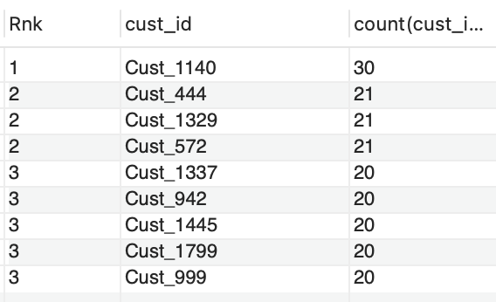
Question 1
Sales and delivery
Find the top 3 customers who have the maximum number of orders
Code:
Output:

Slide 4
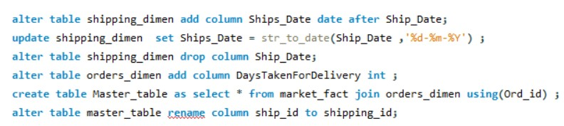
Question 2
Create a new column DaysTakenForDelivery that contains the date difference between Order_Date and Ship_Date.
Code:
Output:

Slide 5
Question 3
Find the customer whose order took the maximum time to get delivered.
Code:
Output:

Slide 6
Question 4
Retrieve total sales made by each product from the data (use Windows function)
Code:
Output:

Slide 7
Question 5
Retrieve the total profit made from each product from the data (use windows function)
Code:
Output:

Slide 8
Question 6
Count the total number of unique customers in January and how many of them came back every month over the entire year in 2011.
Code:
Output:

Slide 9
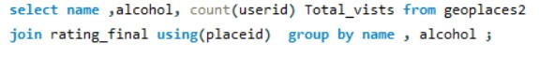
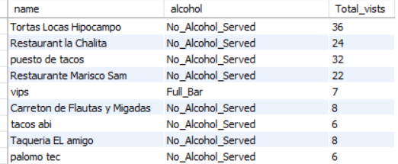
Question 1
Restaurants
We need to find out the total visits to all restaurants under all alcohol categories available.
Code:
Output:

Slide 10
Question 2
Let's find out the average rating according to alcohol and price so that we can understand the rating in respective price categories as well
Code:
Output:

Slide 11
Question 3
Write a query to quantify that what are the parking availability as well in different alcohol categories along with the total number of restaurants
Code:
Output:

Slide 12
Question 4
The percentage of different cuisine in each alcohol type
Code:
Output:

Slide 13
Question 5
The average rating of each state
Code:
Output:

Slide 14
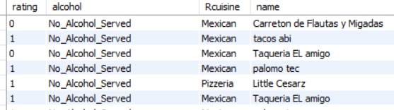
Question 6
' Tamaulipas' Is the lowest average rated state. Quantify the reason why it is the lowest rated by providing the summary on the basis of State, alcohol, and Cuisine.
Code:
Output:
Interpretation :
It looks like Tamaulipas is a dry state and predominantly following Mexican cuisine . Being Dry state and lack of diversity in cuisine leads this cause.

Slide 15
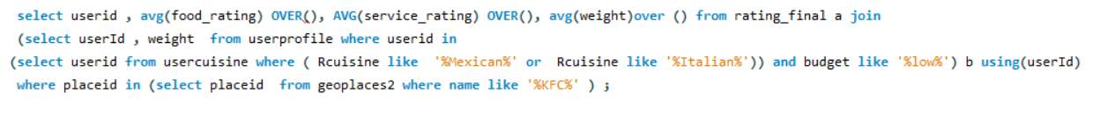
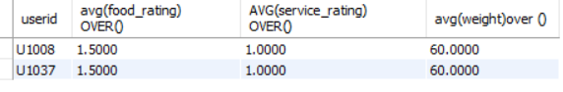
Question 7
Find the average weight, food rating, and service rating of the customers who have visited “KFC”and tried “Mexican” or “Italian” types of cuisine, and also their budget level is low. We encourage you to give it a try by not using joins.
Code:
Output:

Slide 16
Trigger
Create tables
Insert values

Slide 17
Create trigger
Delete a record from the table
Student details backup table
Student details table

Slide 18
THANK YOU

